Slide 1

PMP „The Future of Cyber Security and AI“
(Chair: Prof. Dr. Axel Lehmann)
  PMP-Website: www.unibw.de/infosecur

Slide 2
Digital World – Current Status
In the Digital World of today, social, public and business life depends on:
  *) Hyperconnectivity between “Everything”:
  -> Internet of Everything (IoE: people, systems, environment, …)
  -> “Smart” Systems-of-Systems, e.g. autonomous cars, smart energy grids, e-Health systems, …………….
  *) Artificial Intelligence (AI), e.g. machine / deep learning,
  generative AI such as ChatGPT ,……
  - Ambient computing: Ubiquitous, mostly invisible computing & communication
  - Virtual Worlds, e.g.VR/AR/XR; Computer Games,…
  *) covered in our PMP-meeting and Plenary session

Slide 3
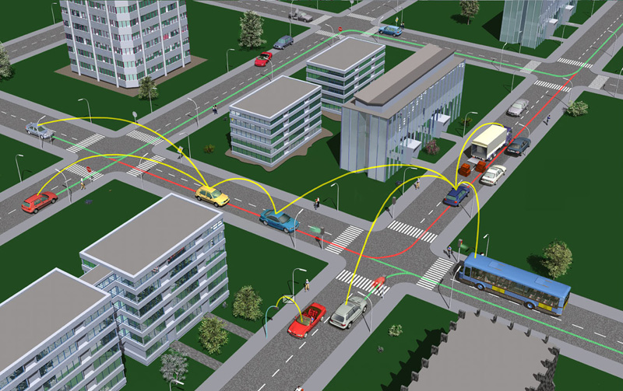
Example: Complexity of Hyperconnectivity + AI regarding Security/ Liability Risks for autonomous driving + Car 2 Car communication
Image: https://www.car-2-car.org/index.php?id=5

Slide 4
Conclusions (1)
    Major technical Challenges & Obligations for the Scientific Community:
    -> Foundations for Mastering the Complexity of Hyperconnectivity and of “Systems-of-Systems”
    -> Principles for Resilient System Design
    -> Measures for interpretation, validation and credibility assurance of AI applications and results
    -> Quality, authentification, security, management of data
    -> Code-of-Conduct, Normative & Legal Basis for AI applications on a global scale
    -> Generation of objective Awareness of benefits and risks of (generative) AI applications to general public

Slide 5
Conclusions (2)
Major social Challenges & Obligations for the Scientific Community:
Erice Declaration to the general public to generate awareness of benefits and risks of Cyber Security and (generative) AI applications from an independent multidisciplinary position
Provide framework for educational programmes on cyber security and AI for public, businesses, politics, …..
Concrete PMP proposal for an „ International School on Artificial Intelligence Technologies and Law“

Slide 6
The PMP „The Future of Cyber Security and AI“
  ….. thanks
  -> WFS for offering this great opportunity for multidisciplinary exchange
  -> the audience in the Plenary session for the intensive discussion and fruitful feedback

Slide 7
PMP „The Future of Cyber Security & AI“
Presentations at the 2024 Plenary Session on Planetary Emergencies:
Perspectives, Risks and Challenges of Cyber Security and AI
“Current Status and associated Challenges of AI”
"The Brave New World of Machines that Make Art, Create Prose and also Think"
“Challenges to AI and its Global Position from an Asian Perspective"
"Immediate Privacy and Cyber Risks from AI and Countering Legislation"
“Advanced Information Management System and Artificial Intelligence”
“AI in Health”

